Slide 1



1
Making you aware
CS577a 17Fall
Team 04

Slide 2
2
:.: Outline
Operational Concept Overview
UI Demo
Test Cases and Results
Quality Focal Point
Transition Plan

Slide 3
3
:.: Operational Concept Overview

Slide 4
:.: Shared Vision: Program Diagram
4
Assumptions: ● Users have iPhone and Internet ● User would like to challenge their friends ● User would like to show their posts
Stakeholders | Initiatives | Value Propositions | Beneficiaries
● Developers ● Client ● Maintainers ● Users | ● Develop the challenge part of the app ● Design the app(UI), advertise the app ● Maintain the app ● Keep using the app and give feedback ● Challenge their friends | ● Attracting more people to join the activities ● To promote activities ● To help students to find out what is happening around them and increase user’s happiness | ● Users ● Client

Slide 5
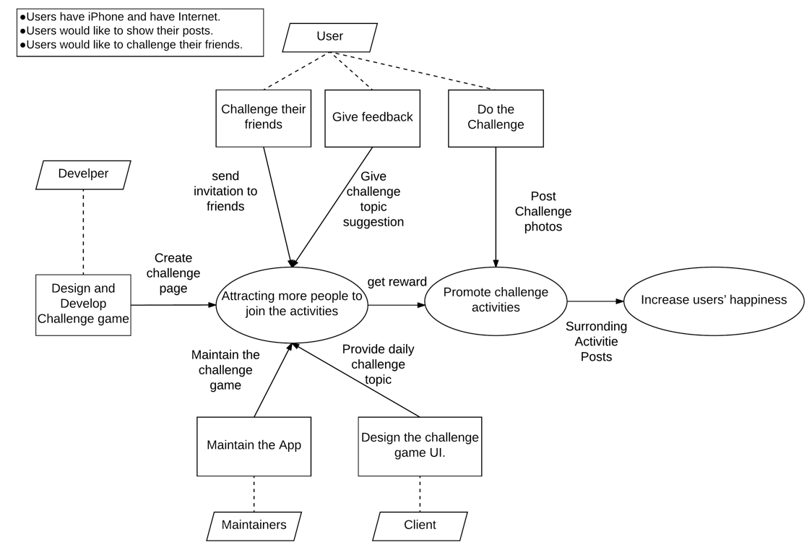
:.: Benefit Chain Diagram
5

Slide 6

:.:System Boundary & Environment
6

Slide 7
:.: Core Capabilities
7
Capability Goals | Priority Level
OC-1 In-App friend List, Phone Contact List Access and SMS: The user can access the iphone contact list and send challenge invitation through iphone msg system, also can send invitation through notification to friends in-App. | MUST HAVE
OC-2 Challenge Complete Competition: The user can choose one friend to compete the time that they finished daily challenge | MUST HAVE
OC-3 Challenge Topic Suggestion: The user can send their feedback and challenge ideas to client | MUST HAVE
OC-4 Upcoming Challenge Post: The system will post upcoming 5 days daily challenge topic. | MUST HAVE
OC-5 View, Approve or Decline Challenge Post: The users are capable of viewing, approve or decline their friends challenge post. | MUST HAVE
OC-6 Challenge Game Pop Screen: The user will touch the pop screen to get all daily challenge information | MUST HAVE
OC-7 Offline & Online Notification: The user will send and get notification from populic. | MUST HAVE
OC-8 Competition Points: The user will get reward points from challenge competition | MUST HAVE

Slide 8
8
:.: Goals & Constraints
OG-1: Enlarge user’s happiness. OG-2: Raise interactions between different users. OG-3: Increase the amount of active users in Populic.
CO-1: iOS as an Operating Systems. CO-2: React Native as a development language for front end. CO-3: Firebase as backend for application notification system. CO-4: MySQL as backend for system.

Slide 9
2
9
:.: Demo

Slide 10
10
:.: Demo
Challenge Homepage Introduction
Challenge Others Page Introduction
Selecting Page Introduction
Competition Page Introduction

Slide 11
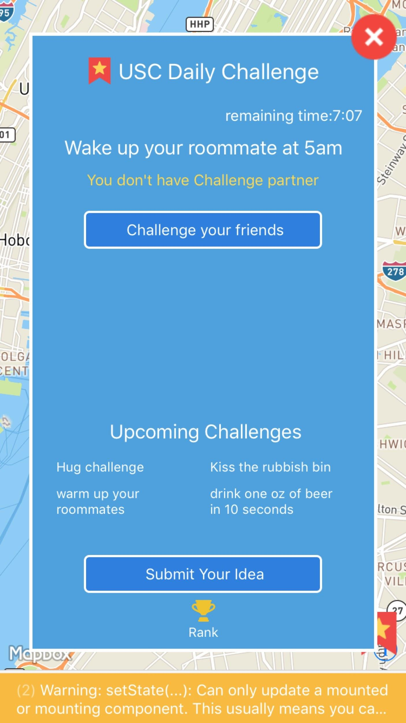
:.: Homepage
11
Today’s challenge
Challenge Others
Upcoming challenge
Provide idea
Rank System

Slide 12
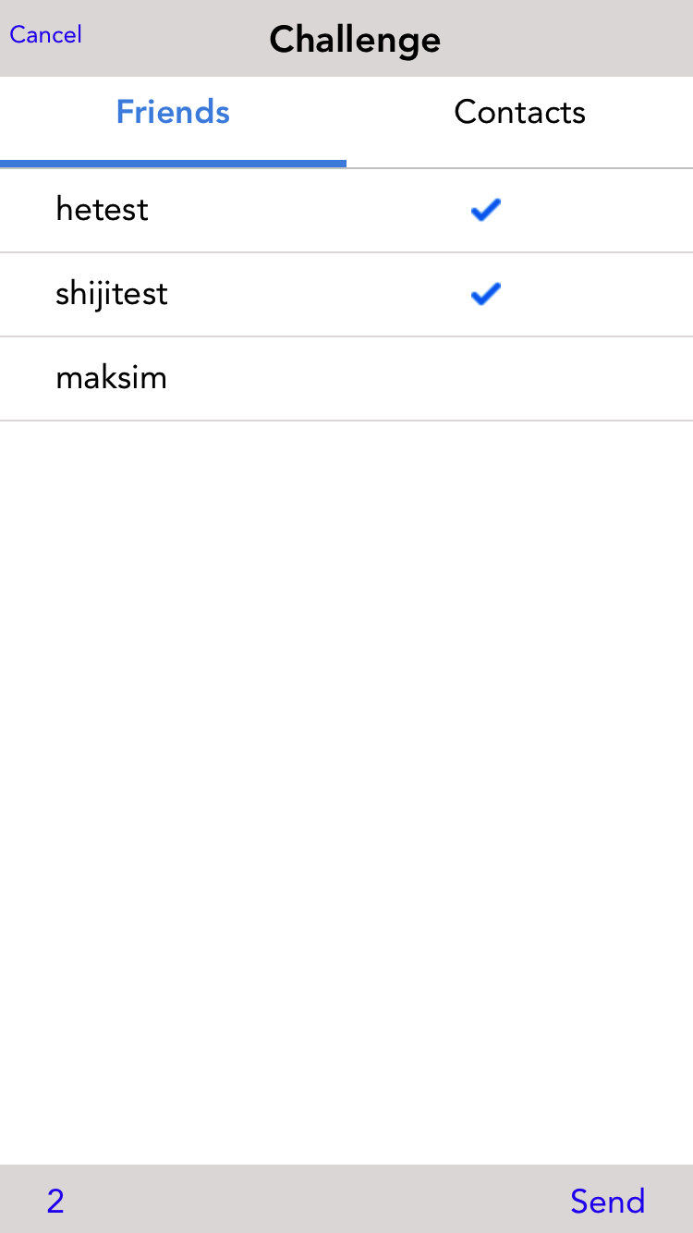
:.: Challenge
Others, cont
13
Two lists
Total number of friends you have challenged
Send challenge request

Slide 13
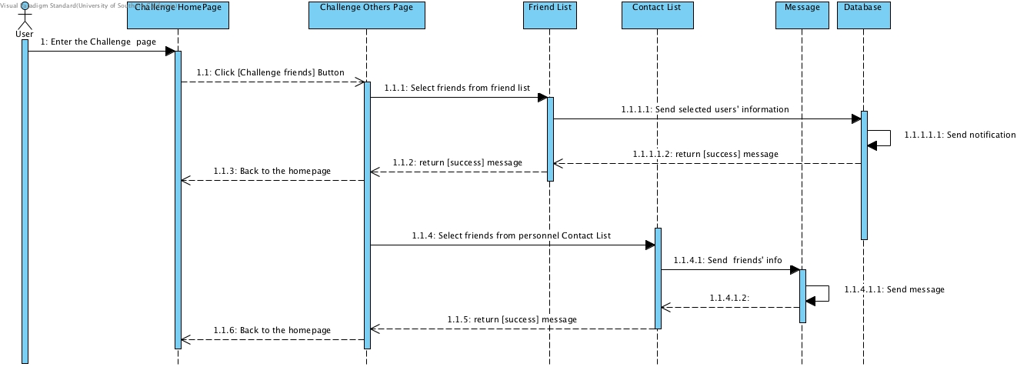
:.: Challenge Others
12

Slide 14
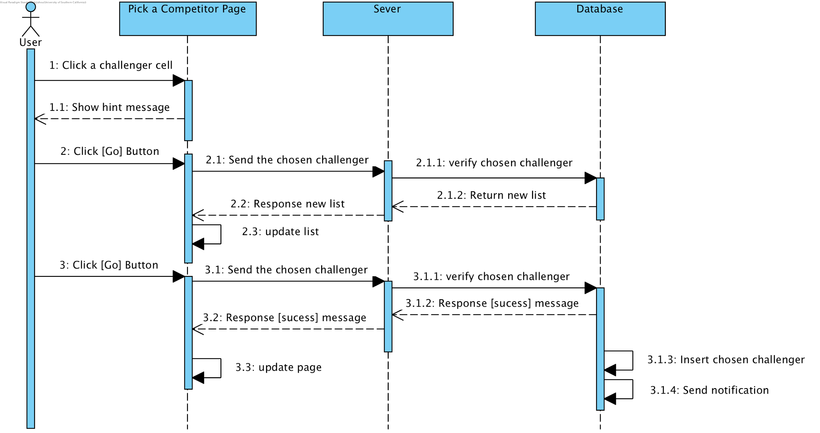
:.: Pick a Competitor
14

Slide 15
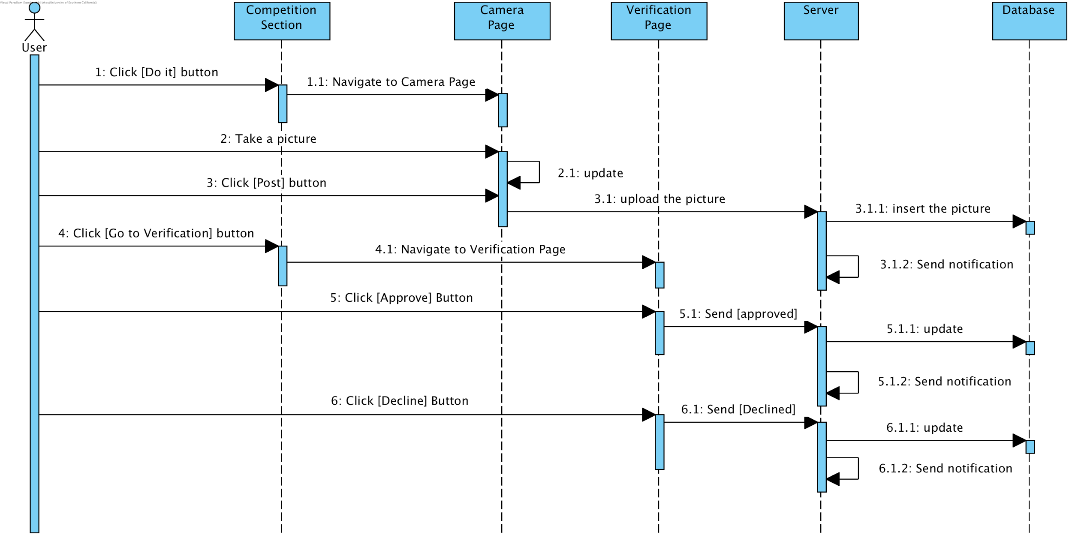
:.: Competition Section
16

Slide 16
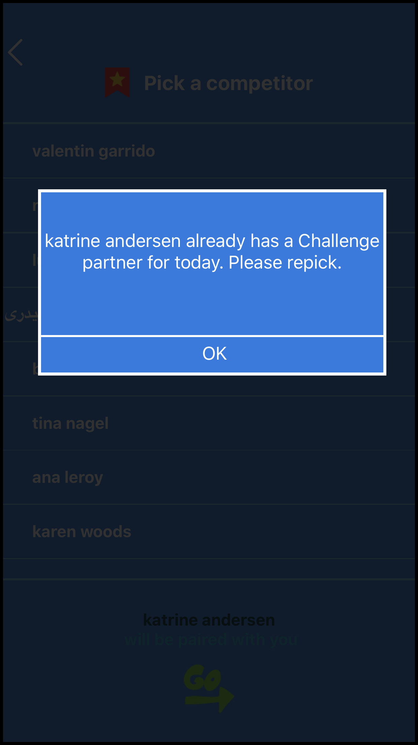
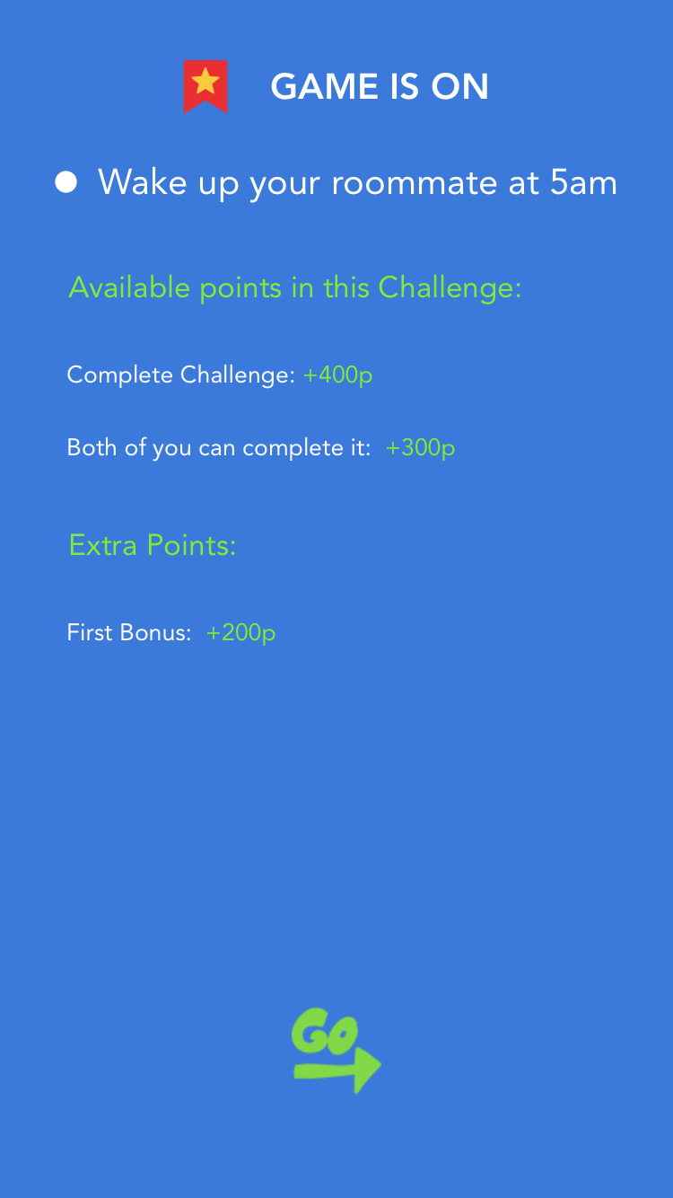
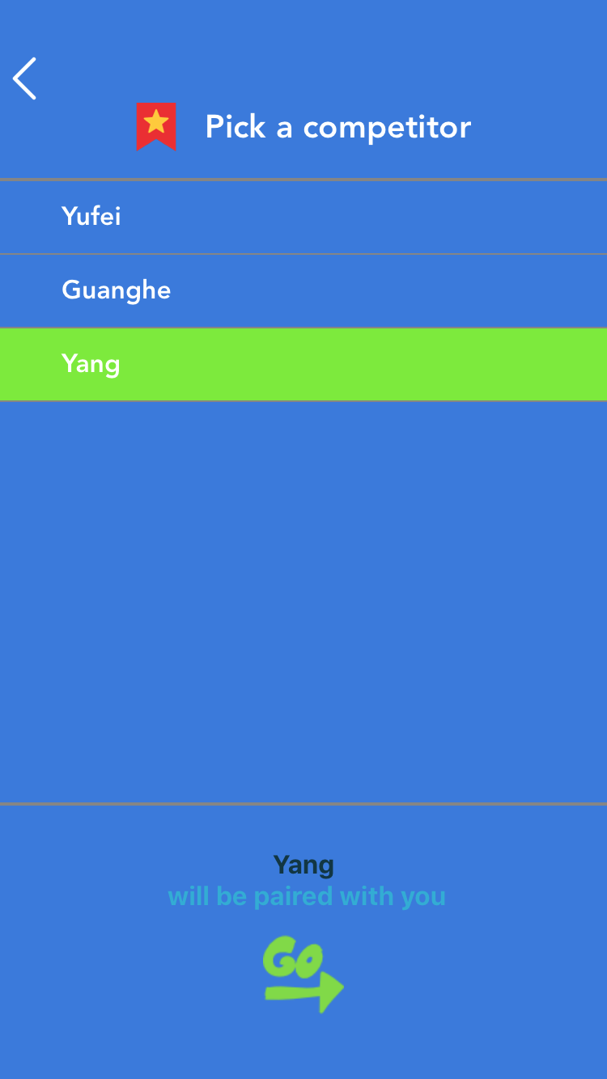
:.: Pick a Competitor
15
Challenger
List
Selected item
Fail:
Alert Dialog
+
Update the List
Succeed:
Challenge information +
Send notification
Hint

Slide 17
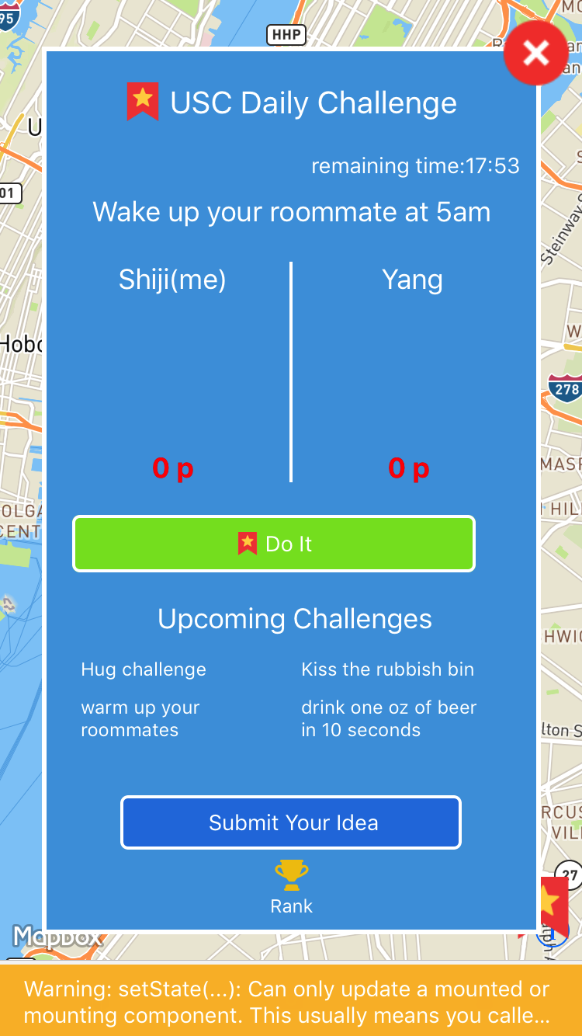
:.: Competition Section
17
Either you or your competitor has 4 status:
Nick name
Information
Haven’t done the challenge
Complete & wait for verification
Have been approved
Have been declined
Scores
“Do it” Button

Slide 18
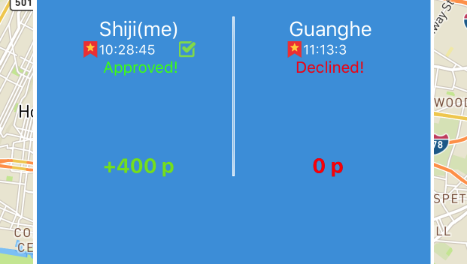
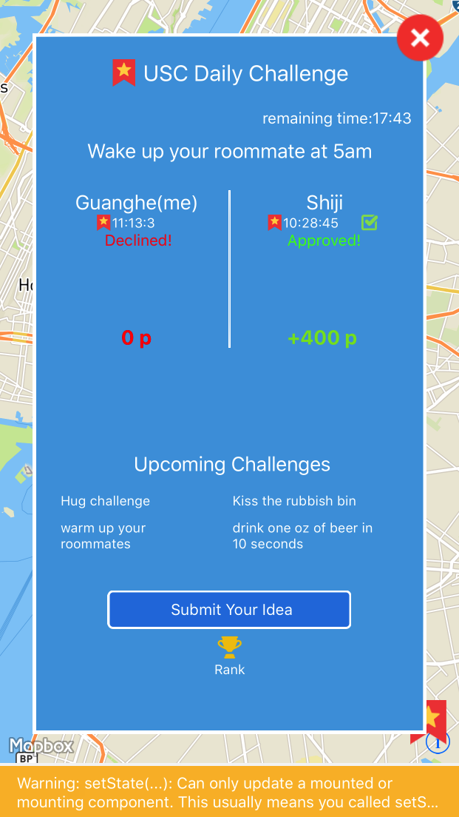


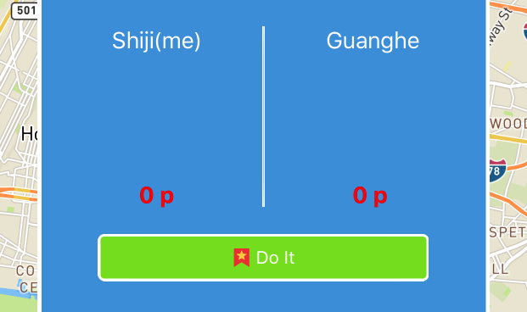
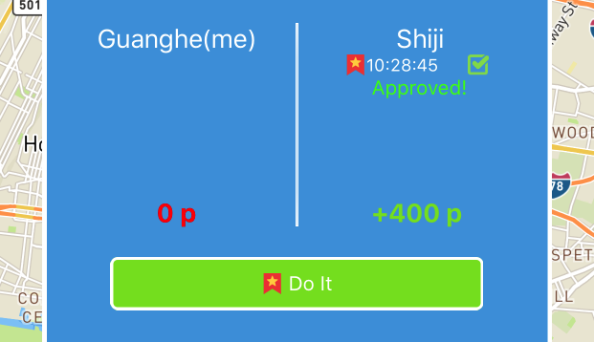


:.: Competition Section
18
status | IsMatched | hasPost | isApproved | isDeclined
1 | False | - | - | -
2 | True | False | - | -
3 | True | True | False | False
4 | True | True | True | False
5 | True | True | False | True
Haven’t done the challenge
Complete & wait for verification
Have been approved
Have been declined
In My App:
In My Competitor's App:

Slide 19
2
19
:.: Test Cases and Results

Slide 20
:.: Overview
20
Purposes
Check if the system meets the requirements
Find faults as early as possible and eliminate them before put into daily use
White box testing
Use white box testing to validate and verify MySQL queries
Black box testing
Scrutinize whether the firebase can send notification correctly
Use the black box testing to check the correctness of various functions, like: Challenging others, competitor selection, score system and rank system

Slide 21
:.: TC-01 Navigation
21
Test Case Number | Test Item | Result
TC-01-01 | The bottom right button in the home map page should link to the pop up challenge page. | Pass
TC-01-02 | The today’s challenge button should link to an extra pop up page in which the detail description of challenge is provided. | Pass
TC-01-03 | The challenger button should navigate users to the competitor selection page. | Pass
TC-01-04 | The submitting button should allow users to submit their own idea about challenge topic to the system. | Pass

Slide 22
:.: TC-01 Navigation
22
Test Case Number | Test Item | Result
TC-01-05 | The rank button in challenge homepage should demonstrate the rank of all users’ scores in non-ascending order. | Pass
TC-01-06 | The challenge friends button should have link to take users to the challenge others page, in which a user can challenge his/her friends from either friend list or contact list. | Pass
TC-01-07-01 | Whenever the user has hitted the send button in challenge others page, if the challenged friends come from Populic, the system should navigate them back to the homepage automatically. If the challenged friends come from contact list, the system should navigate users to message page and allow them to send message. | Pass

Slide 23
:.: TC-01 Navigation
23
Test Case Number | Test Item | Result
TC-01-08 | Whenever the user picked up an available challenger as the competitor, the system should take this user to the competition page. | Pass
TC-01-09 | Whenever the user picked up an unavailable challenger as the competitor, the system should illustrate a dialog to tell this user is unavailable, and then update the competitor candidate list automatically in the selection page. | Pass
TC-01-10 | The do it button in competition page should link to the camera in which a user can take picture/shot a video. | Pass

Slide 24
:.: TC-01 Navigation
24
Test Case Number | Test Item | Result
TC-01-11 | Whenever the user send a challenge post successfully, the system will take this user back to competition page. | Pass
TC-01-12 | The verification button allows a user to approve / disapprove his/her opponent post. | Pass
TC-01-13 | Whenever a user finished the verification process, the system will take him / her back. | Pass
TC-01-14 | The go back button in the top-left corner in every page should take a user back to previous page. | Pass

Slide 25
:.: TC-02 Notification
25
Test Case Number | Test Item | Result
TC-02-01 | The system should send challenge notification to a user if he / she has been challenged by others. | Pass
TC-02-02 | The system should send competitor notification to a user if he / she has successfully been picked up as a competitor with one of his / her friends. | Pass
TC-02-03 | The system should send approving notification to a user immediately after the opponent has completed the challenge. | Pass
TC-02-04 | The system should send the approved / disapproved notification to a user as soon as his / her posts has been verified. | Pass

Slide 26
:.: TC-02 Notification
26
Test Case Number | Test Item | Result
TC-02-05 | The notification should be shown as a dialog at the top of the screen and is supposed to take the user back to our app when he / she clicks it. | Pass
TC-02-06 | Whenever a user receives a notification, the icon should have a red spot at the top-right corner. | Pass
TC-02-07 | The application should take users to Message page and fill in “To:”, textfield automatically when the user want to change friends in contact list. | Pass

Slide 27
:.: TC-03 Competition logic
27
Test Case Number | Test Item | Result
TC-03-01 | If both of two challengers are available (not matched), they are supposed to be matched successfully whenever one of them picks up another. | Pass
TC-03-02 | If one of those two challengers is not available, the database should detect it and forbid the duplicated match. | Pass
TC-03-03 | If two users have challenged the other simultaneously and one of them picked up another in advance, then the status for both of them should be matched. | Pass

Slide 28
28
:.: Quality Focal Point

Slide 29
:.: Traceability Matrix
29
Capability Goals | Requirements | Use Cases | Test Cases
OC-1 In-App friend List, Phone Contact List Access and SMS | WC_4596 | UC-07 | TC-01-07, TC-01-15, TC-01-16
OC-2 Challenge Complete Competition | WC_4596 | UC-03, UC-05 | TC-01-03, TC-03-02, TC-03-03
OC-3 Challenge Topic Suggestion | WC_4601 | UC-06, UC-10 | TC-01-04
OC-4 Upcoming Challenge Post | WC_4595 | UC-02 | TC-01-02
Notes:
Purpose: Links requirements to Capability Goals through the validation process
Ensures All Requirements are Covered with Test Cases Coverage (Assurity That Every Aspect Is Met) Allows Traceability of Derivation from Capability Goals to Test Cases

Slide 30
:.: Traceability Matrix
30
Capability Goals | Requirements | Use Cases | Test Cases
OC-5 View Approve or Decline Challenge | WC_4537, WC_4600 | UC-08 | TC-01-06, TC-01-12
OC-6 Challenge Game Pop Screen | WC_4531 | UC-01 | TC-01-02
OC-7 Offline and Online Notifications | WC_4599 | UC-03, UC-05 | TC-02-01, TC-02-02, TC-02-03, TC-02-04, TC-02-05, TC-02-06
OC-8 Competition Points | WC_4598 | UC-05 | TC-01-05,

Slide 31
:.: Technical Debt
31
Solved
Slight inconsistencies between modules and coding styles. Solved: By implementing similar modular structure and file naming. For Push Notifications Modules, coding structures were refactored to mock existing code modules. Spent extra time into refactoring.
Parallel Development - Separation of development branches Solved: Coordination between developers and coordinating code reviews through meetings.
Lack Of Knowledge - Solved: Investing time to learn new technologies such as react native and redux.

Slide 32
:.: Technical Debt
32
Remaining
Sending Text Messages From Backend Requires Alternative Method. Navigation to Messenger app. Text Message r equires Sim Card to send.
Notifications(Game) - Implemented to meet requirements and be workable. Method of implementation disallows for further additional features associated with task (User Navigation to Corresponding Page)
Code Formatting - File Splitting (Backend Code) Takes time scrolling through file to find code segments
Lack of Alignment of Standards - Ignored Some slight standards for code in order to deliver workable project
Notes:
Lack of Alignment of Standards: Constant string and database management, Module Organization(Readability Organization). Code Longevity.

Slide 33
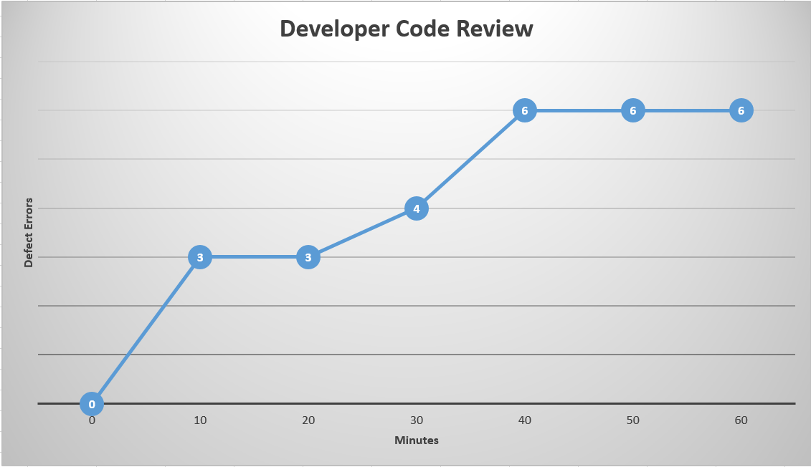
:.: Metric: Developer Code Review
33
Notes:
Takes about 40 min to find all the defects. After that it becomes inefficient to keep searching. Short Bursts of code review.

Slide 34
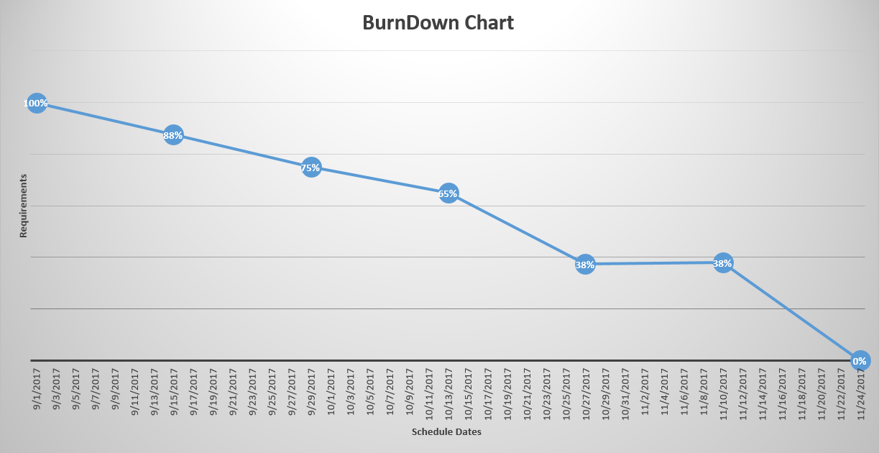
:.: Metric: BurnDown Chart
34
Notes:
Metric Used for charting progress across the course of the semester.

Slide 35
2
35
:.: Transition Plan

Slide 36
36
:.: Objective of Transition Plan
Get ready for transition and test
Deploy our app on our client’s server
Test and evaluate app on our client’s server
Deliver all the source code and the document

Slide 37
:.: Preparation
37
Category | Item
Hardware | Macbook(several), iPhone(several)
Software | Xcode,Webstorm, React Native, Mysql,Firebase,Ubuntu14.0.4, Nodejs, GitHub
Site | On campus
Staff | Developer Team, Tester, Trainer, Client

Slide 38
:.: Operation
38
Category | Operation
Testing | Provide Testing Document and Acceptable Test Case (We have done beta test,find several bugs and fixed most)
Training | Provide Technical Support and Document (Our app is not obvious to use, but we write a easily readable manual for user to operate)
Evaluation | Client Feedback (We have received the beta test feedback and trying to satisfy all the reasonable requirement)

Slide 39
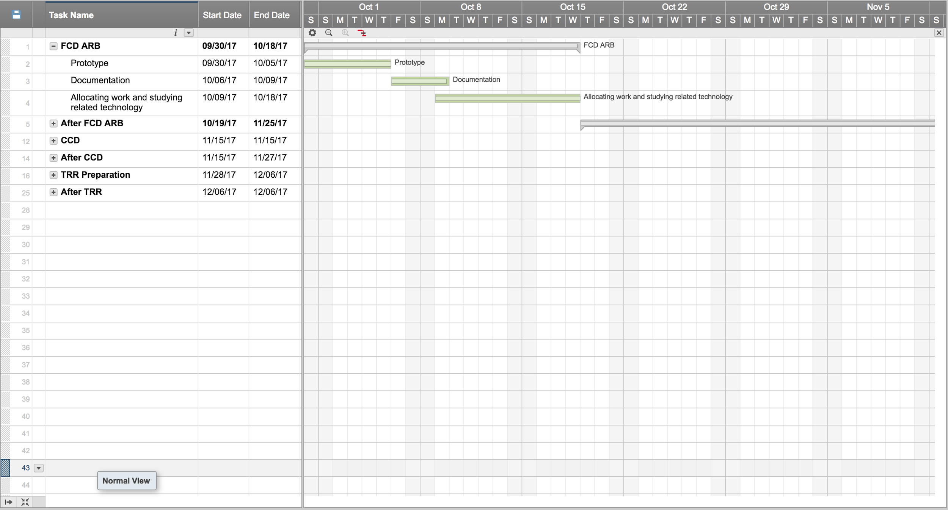
:.: Milestones Plan
42

Slide 40
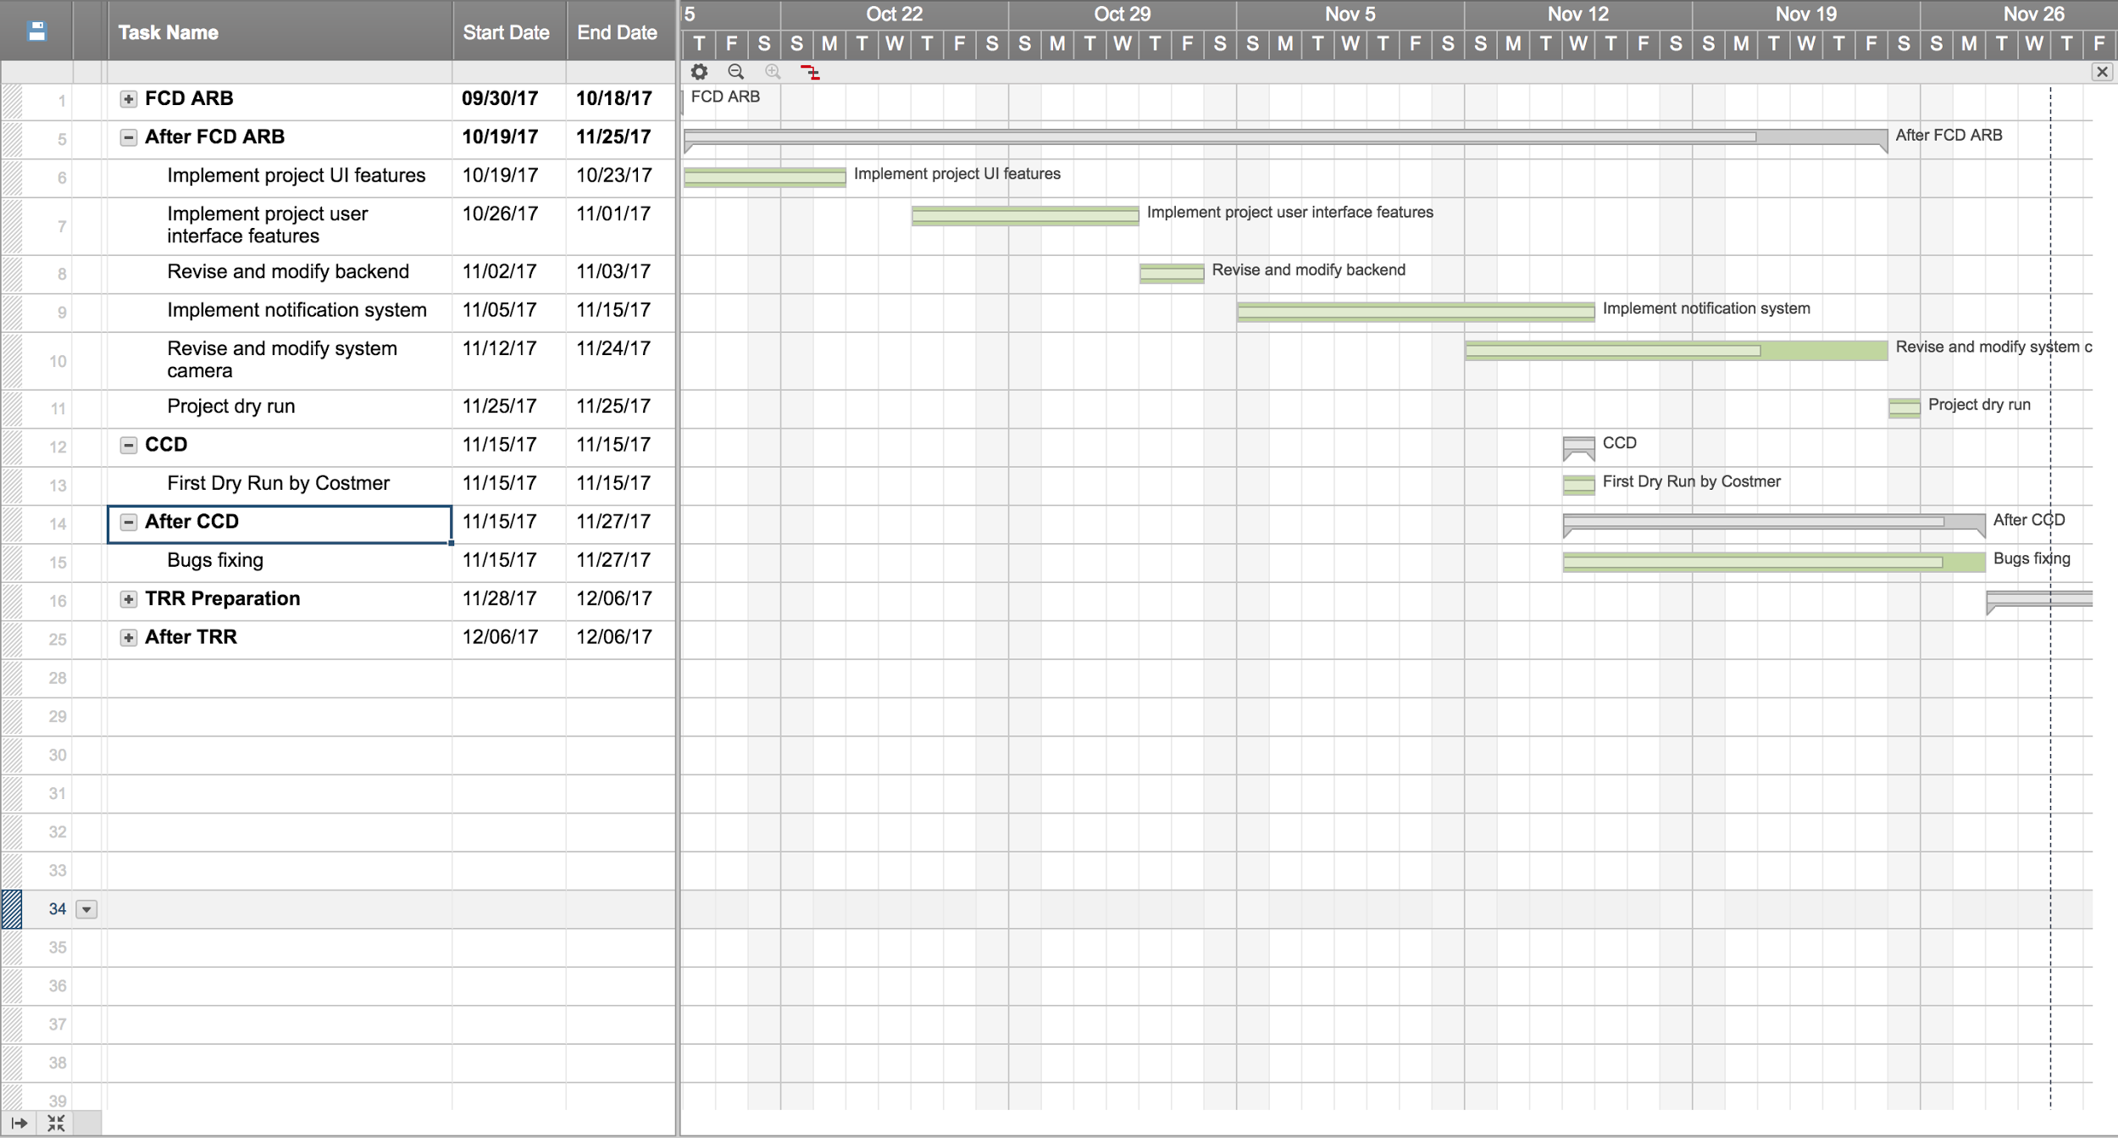
:.: Milestones Plan
42

Slide 41
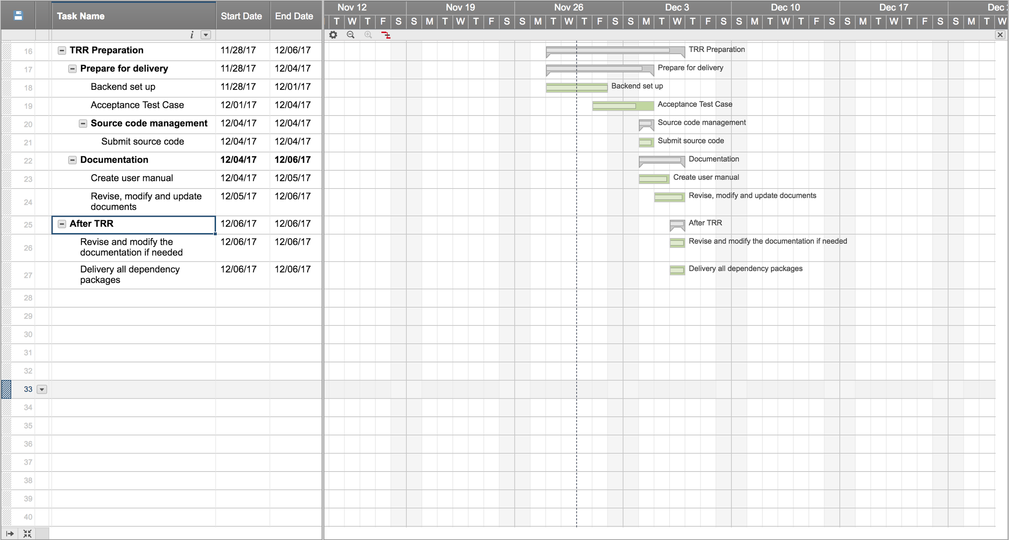
:.: Milestones Plan
42

Slide 42
:.: Stakeholder Role & Responsibilities
39
Date | Role | Responsibility
12/01/17 | client | Provide authorization of firebase and maintenance and update schedule
12/04/17 | Front-end team | Fix bugs / Test / Provide technical support
12/04/17 | Back-end team | Offer all the challenge API and database Schema.
12/06/17 | Team | Have all documents ready and deliver the whole function
12/06/17 | Maintainer | Learn to maintain upcoming challenge
Notes:
Table
generate service account credentials
We have been found

Slide 43
:.: Transition Risks
40
Maintenance
Project meeting.
Work breakdown document
User manual
Maintenance video
Ambiguous code
refactor the code
Finish the comment and document of our code
Notes:
If possible, we can set up a meeting with maintainer to talk about the structure and details of our project
to make it clean and readable.
mitigate

Slide 44
:.: Required Resources
41
Technical Manual
Guide on Setting up FireBase
DB Schema
Software Product Elements
Guide on how to manage Database.
User Manual
Simple guide on how to use main features of challenge function.
Display of difference situation
Source Code
Github
Notes:
Talbe object clas
If possible, we can set up a meeting with maintainer to talk about the structure and details of our project
as class diagram program diagram boundary diagram
Skimə
Repositories

Slide 45
43
:.: Q & A

